Slide 1

Rungta College of Engineering Technology R1, Bhilai Allied Department of Computer Science & Engineering(AI&ML) 5th semester
Team Members
Anurag Yadav- 301310922041
Anmol Kumar- 301310922020
Supriya Dhara- 301310922009
S Nimmi- 301310922114
Project Incharge
Prof .Prabhjeet Kaur

Slide 2

DeepCrop: Leveraging Deep Learning for Predictive Analysis of Crop Diseases

Slide 3
Problem Statement
Agriculture is a cornerstone of global food security and economic development, but it faces significant challenges due to crop diseases. These diseases can lead to:
Decreased Yield: Infected crops can suffer from reduced growth and productivity, directly impacting food supply and farmers' livelihoods.
Economic Losses: Farmers can incur substantial financial losses due to reduced crop quality and quantity, leading to increased food prices and economic instability in agricultural communities.
Lack of Timely Diagnosis: Traditional methods of diagnosing crop diseases often rely on the expertise of agronomists or extension workers, which may not be readily available, especially in rural areas.
Inadequate Information Dissemination: Farmers may not have access to timely and accurate information regarding disease outbreaks, preventive measures, and effective treatments.
Environmental Impact: The indiscriminate use of pesticides to combat crop diseases can lead to adverse environmental effects and resistance among pathogens.

Slide 4
Solution
Deep Crop addresses the challenges posed by crop diseases through the development of a deep learning-based prediction system. The solution includes:
Deep Learning Algorithms: Utilizing advanced convolutional neural networks (CNNs) to analyze images of crops and identify signs of diseases with high accuracy.
User-Friendly Platform: Providing farmers with an accessible platform to upload images of their crops and receive instant feedback on potential diseases, along with recommended actions.
Real-Time Disease Monitoring: Implementing a system that allows for continuous monitoring and tracking of crop health, enabling proactive management and timely interventions.
Educational Resources: Offering information and resources on crop diseases, including symptoms, causes, and management strategies, helping farmers make informed decisions.
Community Engagement: Creating a platform for farmers to share their experiences and outcomes, fostering a community of practice focused on sustainable agricultural methods.

Slide 5



Introduction to DeepCrop
DeepCrop is an innovative platform utilizing deep learning techniques to predict crop diseases. This presentation will explore its functionalities, methodologies, and the impact of predictive analysis on agricultural practices, ultimately enhancing crop management and yield.

Slide 6
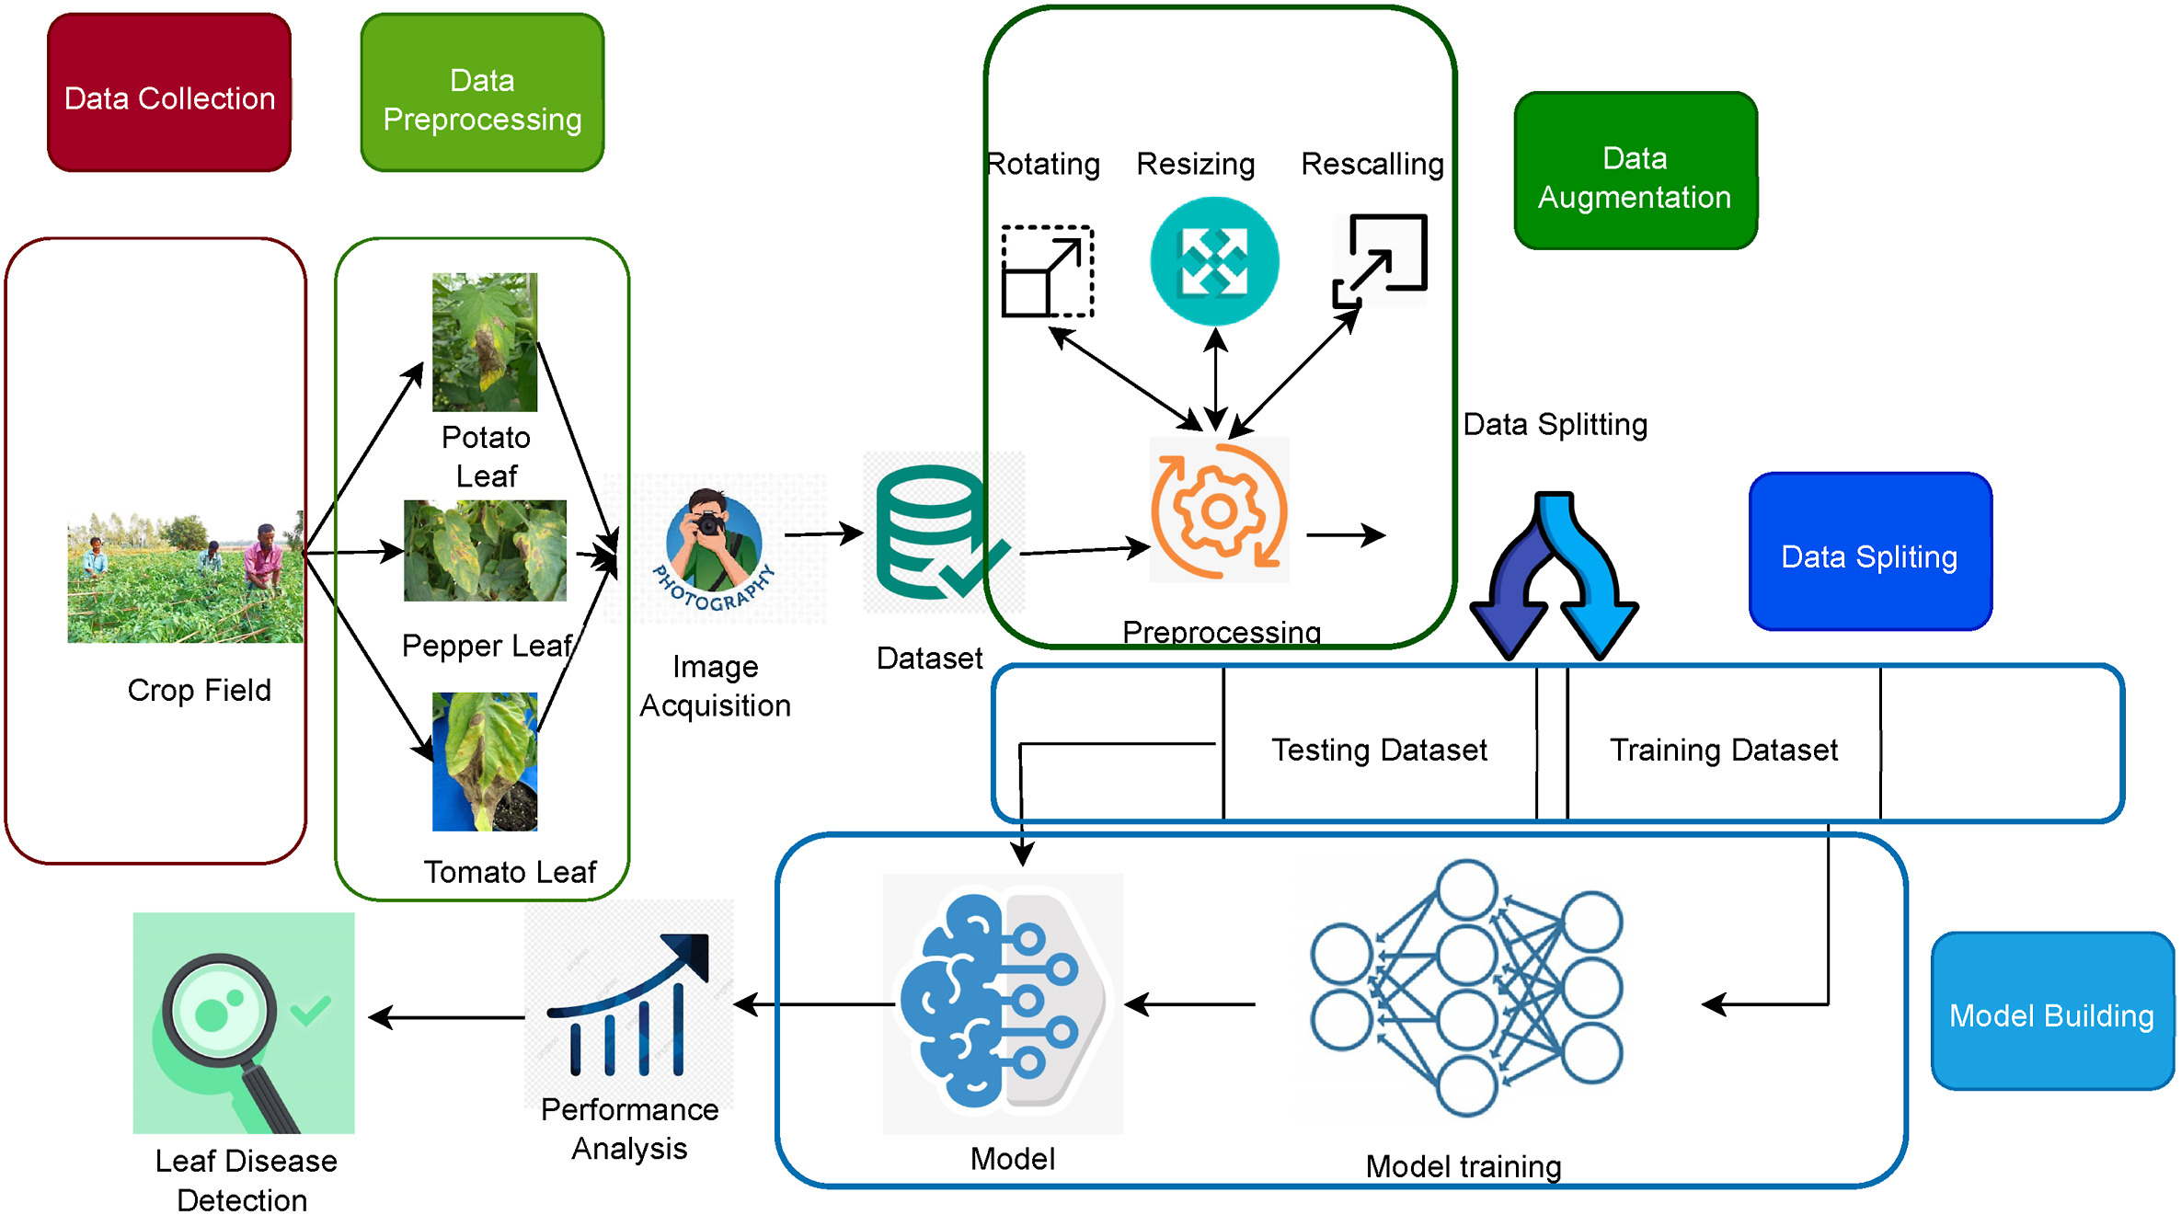
Proposed work-flow diagram

Slide 7
Dataset The proposal starts with collecting the input images representing different types of leaves. These raw images can be collected using a real-time camera or mobile. For our deployment, the deep learning model was trained using a publicly accessible dataset during the framework's testing and training phases.
Preprocessing
The raw images collected from the dataset might contain noises and it is essential to preprocess them before fitting them into the learning module. We apply rotation, resizing, and shearing to preprocess the image during the preprocessing phase.
Training and building the model
This step has two main phases. The TL models are trained using a training image dataset during the first phase. During the later phase, the architecture is validated using test images reserved for performance evaluation.
Model construction
•Collecting images from the dataset.
Pre-process image data by resizing and rotating images.
Creating convolute feature connect into Fully Connected Layers. Usually, it is flattened, converted to a one-dimensional (1D) array (or vector), and then joined to one or more completely connected layers.
Finally, extract the features for different classes of the input.

Slide 8
Model evaluation
From an ideal dataset, 80% of photos are taken for training and 20% for testing.
Validation data is used to check accuracy by applying the predict function and accurately extracting features.
Images are taken for confirming detection once validation provides good results.
Finally, characteristics are retrieved to determine whether or not the leaves are infected.
Performance evaluation
In this phase, we obtain the best model based on the performance of the extensive experiments. We used accuracy, precision, recall, f1score, training accuracy, training loss, validation accuracy, and validation loss. This will help to build the smart web application with deep learning guidance.

Slide 9
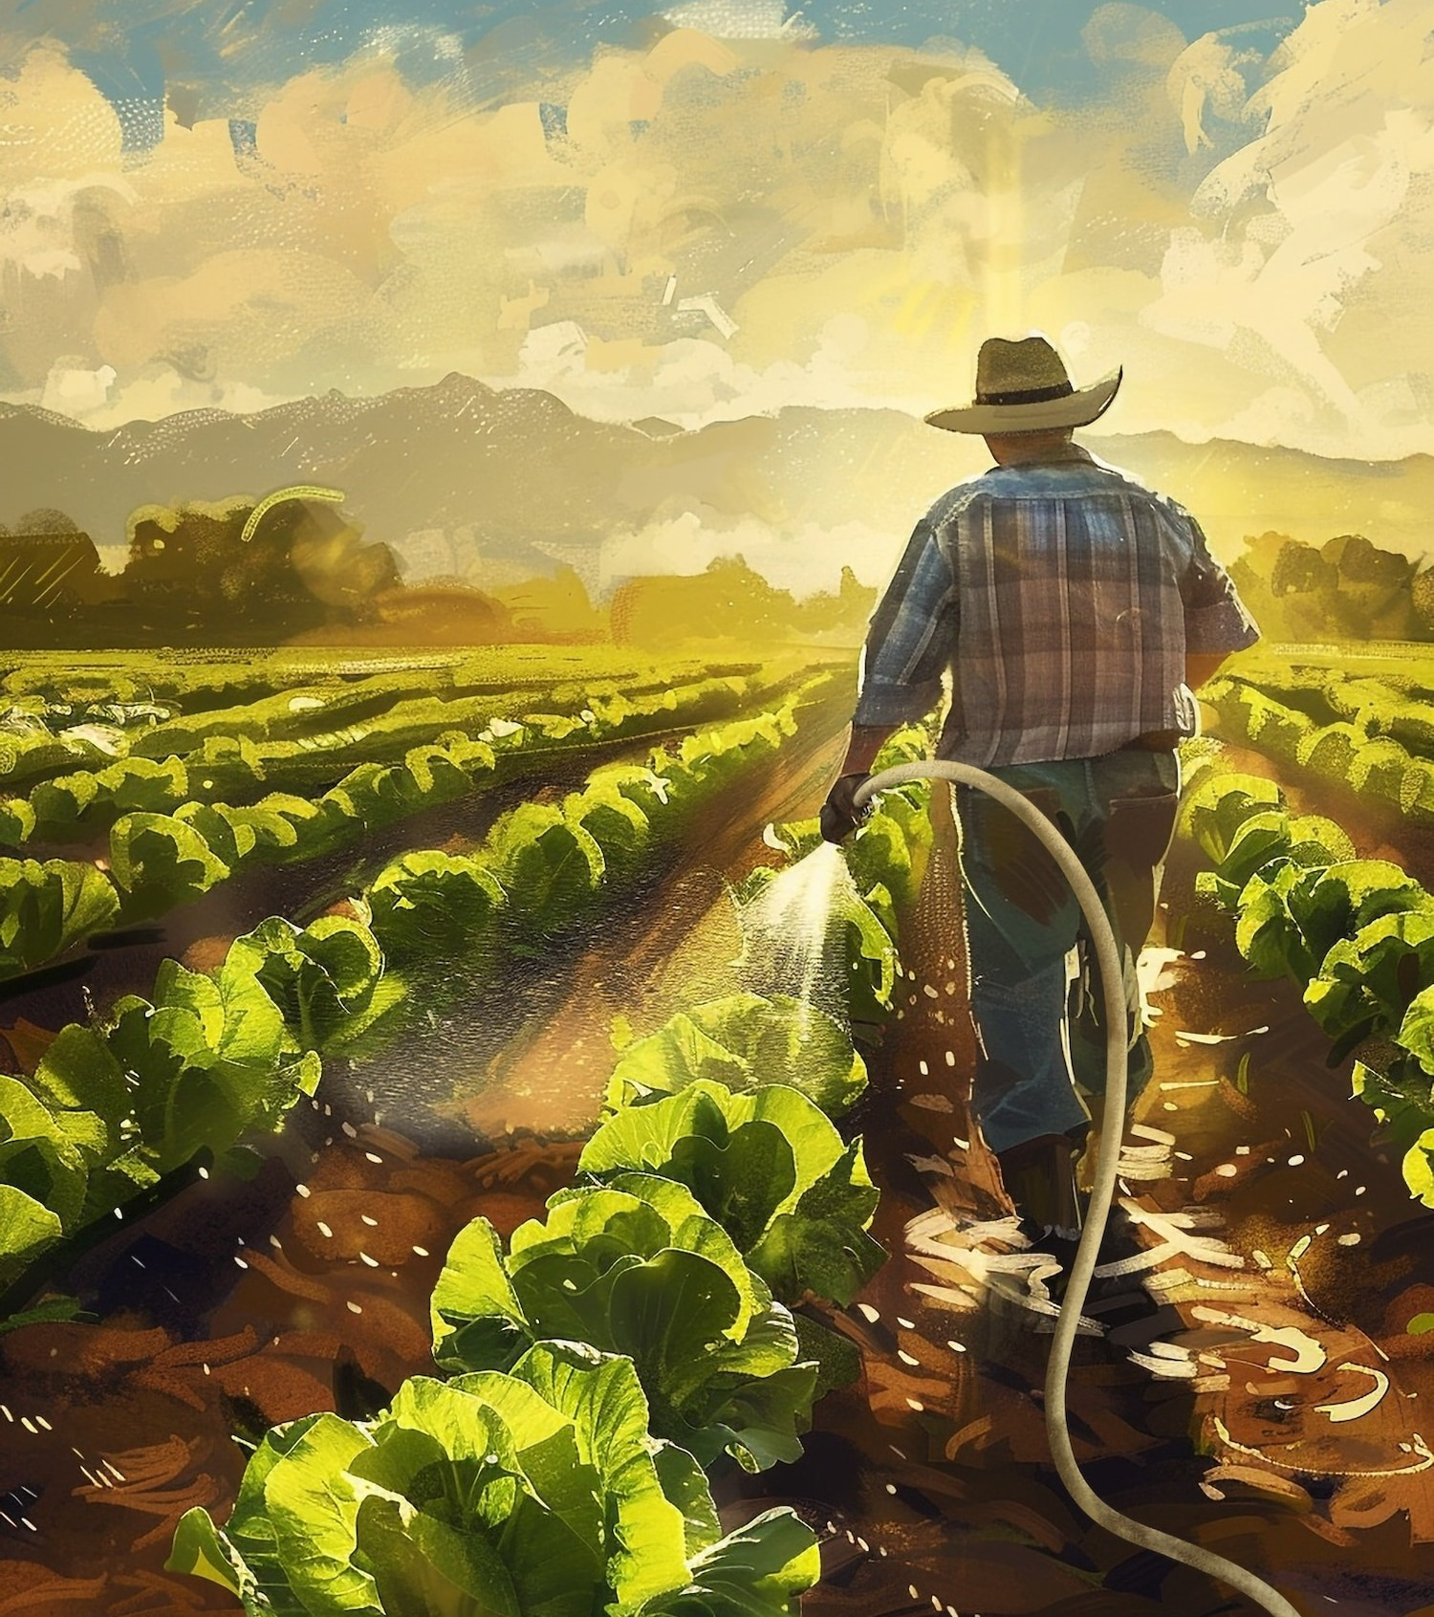


Importance of Crop Disease Prediction
Predicting crop diseases is crucial for sustainable agriculture. Early detection can signiﬁcantly reduce losses, ensuring the food supply remains stable. By utilizing advanced technologies like deep learning, farmers can make informed decisions and optimize their crop management
strategies.

Slide 10





Deep Learning Overview
Deep learning is a subset of machine learning that uses neural networks to analyze vast amounts of data. It excels in pattern recognition, making it ideal for identifying symptoms of crop diseases through images and historical
data analysis.

Slide 11


Data Collection and Training
For effective predictions, a robust dataset is essential. DeepCrop utilizes diverse datasets containing images of healthy and diseased crops. This data is used to train the deep learning model, enhancing its accuracy and reliability in real-world scenarios.

Slide 12
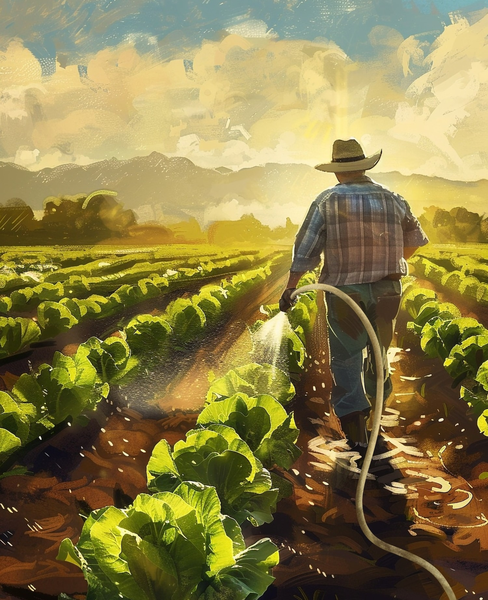

Impact on Agriculture
The implementation of DeepCrop can lead to signiﬁcant advancements in agricultural productivity. By minimizing crop losses and improving disease management, farmers can achieve higher yields and contribute to food security, beneﬁting both the economy and society.

Slide 13
Conclusion and Future Work
In conclusion, DeepCrop represents a pivotal shift in how we approach crop disease management. Future work will focus on enhancing the model's capabilities and expanding its database, ensuring it remains a vital resource for farmers worldwide.

